Slide 1

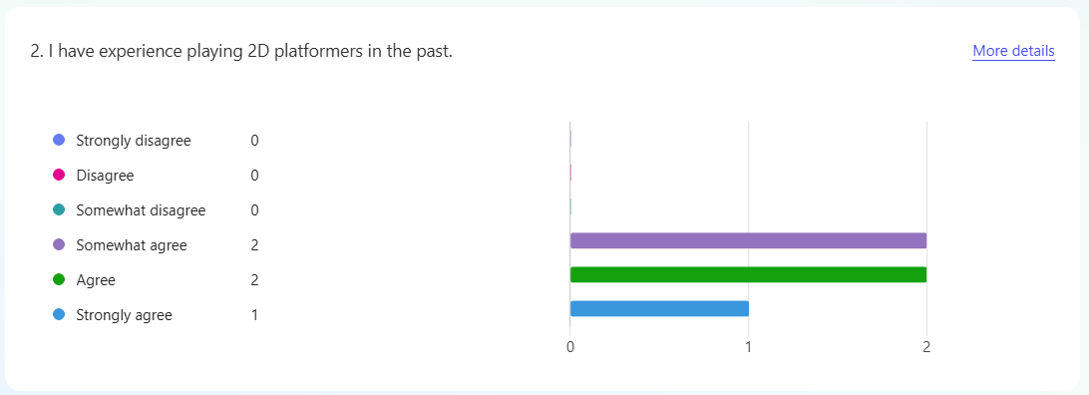
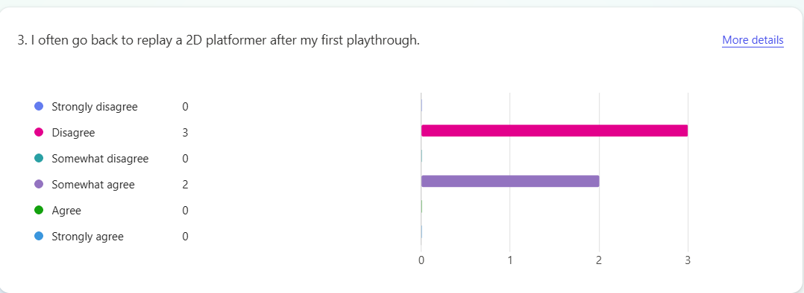
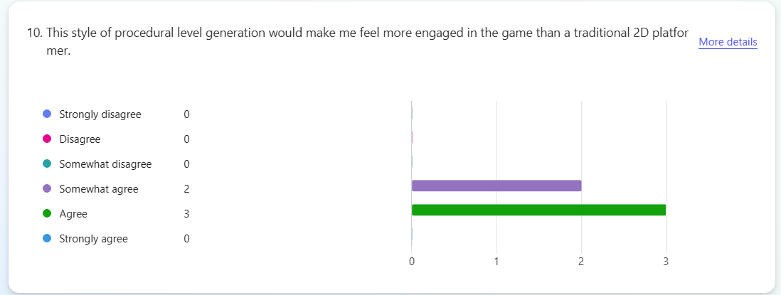
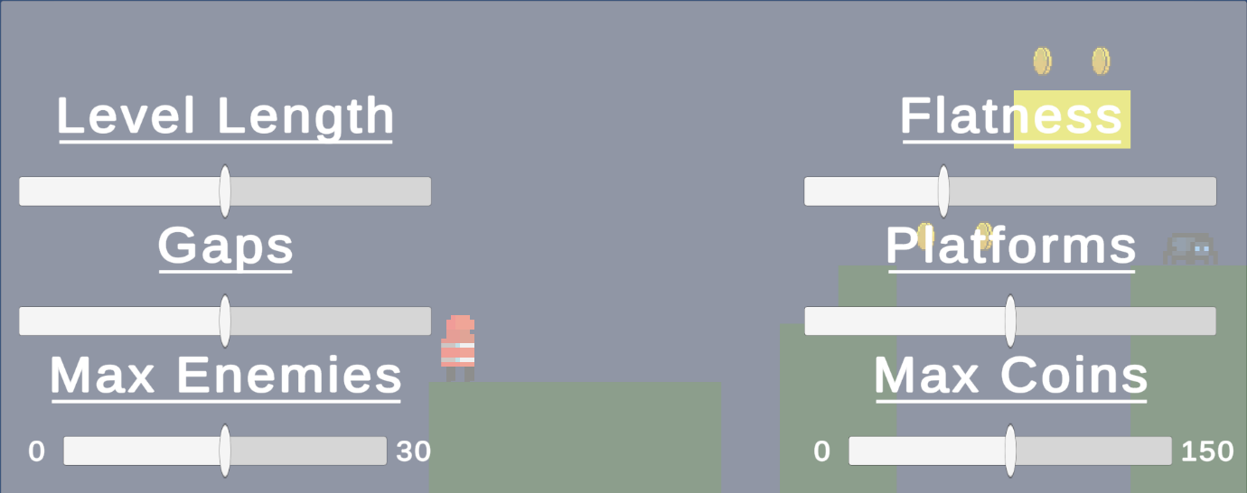
Procedural Level Generation in 2D Platformers
Callum Myers
Course e.g. BSc (Hons) Computer Games Application Development
Introduction
Method
Results
Discussion
With the sheer volume of games being released each years, developers need a way to stand out. An excellent way to do this is by giving players a range of content to explore and keep them engaged.
The Super Mario Bros franchise from Nintendo demonstrates this. Between the original game, released in 1985, and the release on the Nintendo Wii U in 2013, the number of playable levels in the games shot up from 32, to 117. This allowed Nintendo to keep up with the ever-increasing and improving games market.
This however, also required a huge increase in developers, from 5 in 1985, to 90 in 2013. This can be helped using procedural content, where content can be generated through an algorithm, as opposed to by hand.
Software:
It was decided that the Unity game engine would be used due to its extensive community and having built-in Perlin Noise functions.
Application Flow:
To achieve the desired output, the application would layer 4 separate stages to build a level:
Perlin Noise will be used to create a simple base terrain for the level to build around.
Markov Chains will then be used to add gaps and platforms to appropriate areas around the level.
Markov Chains will be used again, this time to add enemies across the level.
Markov Chains will be used for a final time to add collectable coins for the players to find throughout the level.
Parameter Editing:
Since this application was developed to be a small tool in a larger-scale game, some parameters were included to allow developers to tweak levels as they saw fit, without editing the model itself.
The included menu is as seen below, and lets developers adapt sections of the algorithm:
Tester Survey:
The survey given to participants followed a simple layout, where testers were first asked some questions about their past experiences with 2D platformers, experience with the project as a standalone application, then a comparison between the levels created by the model, and levels in other 2D platformers they have played.
Key Survey Responses:
All testers have some experience playing 2D platformers in the past.
Most players do not go back to replay platformers after initially completing them.
All players feel this method of level generation would improve the chance of them playing a platformer more than once, when compared to standard methods of level generation.
Scope and Implementation:
The project’s scope was mainly suitable, as all major planned features were successfully implemented. However, some smaller planned features did not fit within the project’s final timeframe.
Testing Suitability:
The testers who participated were well selected, having all had prior experience with similar games to compare the project to. It would have been beneficial to gain a larger sample size for more reliable results.
Aim:
The project was successful in creating a model which would improve replayability, as shown by the positive responses to the questions in the results section. It showed testers found this method of generation more interesting and resulted in more varied levels.
Aim
Research Question:
How can procedural level generation be used to lengthen a player’s playtime and improve player engagement in 2D platformer games?
Aim:
This project aims to investigate and analyse the benefits of procedural generation algorithms when creating levels for 2D platformers, then consider how this could be used to lengthen the time a player can stay engaged with the game.
This project was carried out with the hopes that the research done could aid in improving games in the future, by demonstrating how procedural level generation can elevate both the quality and quantity of content.
Conclusion
In conclusion, the project can be deemed a success. It managed to achieve both the aims and objectives laid out during planning. A longer time frame may allow for some additional features to the tool which may make the model more suitable for a large-scale game, but this is a solid base.
References
Nintendo - Inside Nintendo 47: Das Super Mario-Entwicklerteam unter der Lupe. (2013)
Gillian Smith - Understanding procedural content generation. (2014)

